Slide 1

Nutrients
BBA 1st SEM (2022-23)
Submitted By-
Shankh Bansal
Submitted To-
Dr. Gaurav Bagra

Slide 2
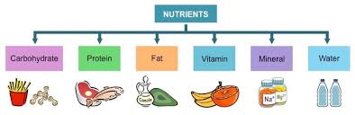
Concept map

Slide 3
Objective
Define food or nutrients.
Differentiate between different components of food.
Know about different function of different components of food.

Slide 4
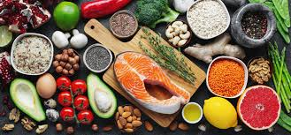
Food
Any nutritious substance that people or animal eat or drink or that plant absorb in order to maintain life and growth is called food. It is also known as nutrients.

Slide 5
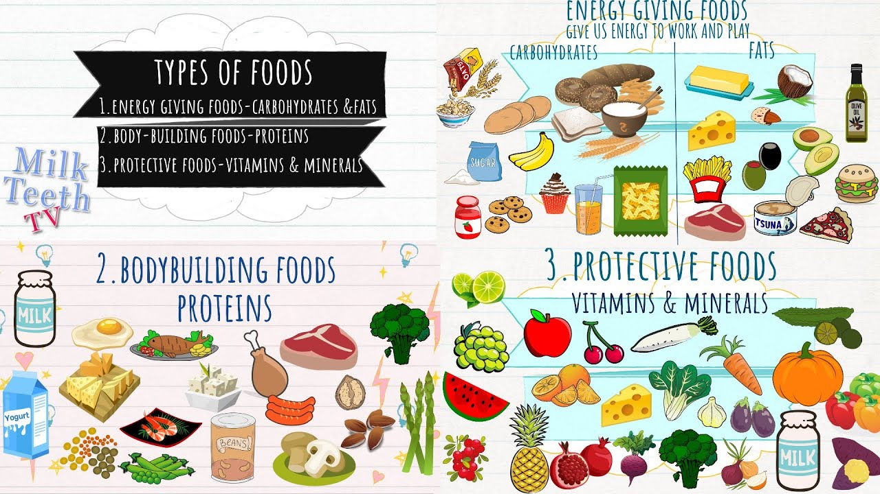
Classification of food group.

Slide 6
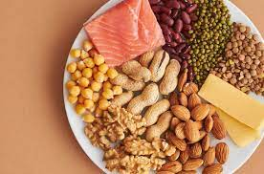
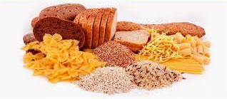
Protein
Carbohydrates
It Helps in repairing wore out tissue.
Protein helps in the formation of hairs and nails etc.
All organisms use them for energy.
Reserve food material.
Formation of cell organelle and cell compounds.

Slide 7
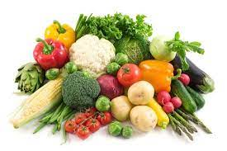
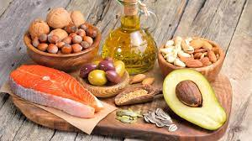
Fats
Vitamins
Is a source of energy.
Adds taste and texture to the food .
Helps absorb fat soluble vitamins.
Compounds needed in small amounts to regulate body processes and regulate growth.
Helps in :-
Digestion
Absorption
Metabolism

Slide 8
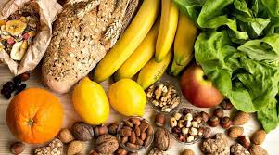
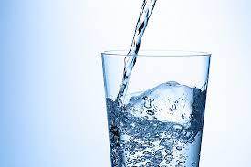
Minerals
Water
Naturally occurring inorganic substances.
Production of hormone
Acid base and water balance ( Na,K,Cl)
A major portion of our body is formed of protein.
Helps in absorbing nutrients from food.
It is essential for most of the body functions.

Slide 9
References
https://www.youtube.com/results?search_query=nutrition
https://www.google.com/search?q=food+nutrition&tbm=isch&ved=2ahUKEwjhtsSGgLf7AhXek9gFHXvnBQoQ2

